Slide 1


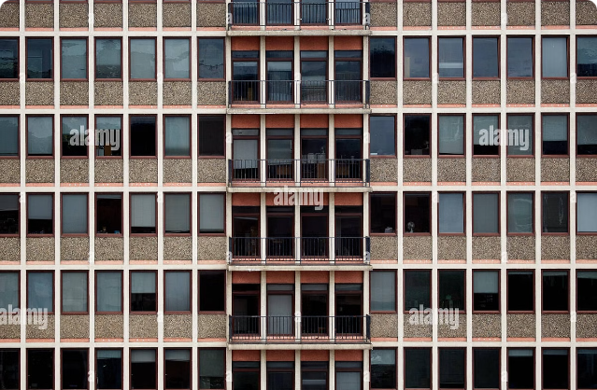
Secure Authorization ID System for Government Grocery Program
This presentation outlines a blockchain-based solution for securing and streamlining government grocery programs. The proposed system aims to combat fraud, enhance transparency, and improve efficiency in the distribution of essential food resources.

Slide 2

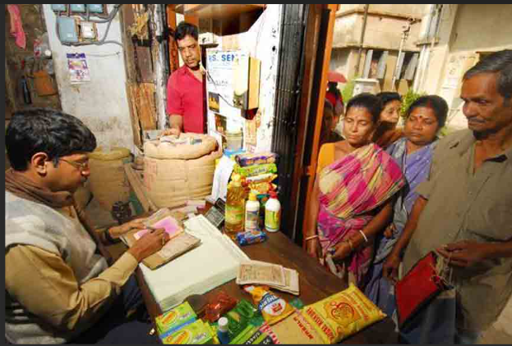
Problem Statement
1
Fraudulent Claims
Dishonest individuals often exploit government programs by making false claims, leading to financial losses and resource misallocation.
2
Duplicate Registrations
Multiple registrations under the same or different identities can create lead to the over-allocation of resources.
3
Inefficient Tracking
Traditional systems struggle to track transactions efficiently, making it difficult to monitor program effectiveness and identify potential irregularities.
4
Lack of Transparency
Opaque systems lack transparency, making it challenging for beneficiaries, program administrators, and the public to verify the legitimacy of transactions and ensure accountability.

Slide 3

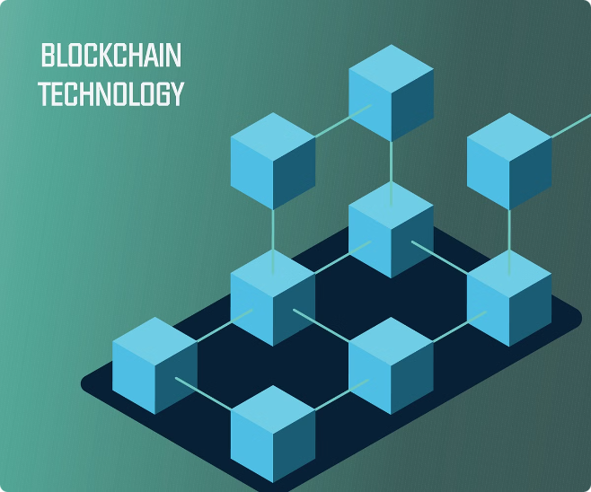
Proposed Solution
Secure Authorization IDs
Utilizing blockchain technology, each eligible user receives a unique and immutable authorization ID, preventing duplication and misuse.
Efficient Eligibility Verification
The system automates the verification process, enabling real-time checks against a secure database to confirm user eligibility.
Transparent Transaction Logs
Every transaction is recorded on the blockchain, providing an immutable and verifiable record, enhancing transparency and accountability.
Fraud Prevention
The system's robust security features and tamper-proof transaction logs significantly mitigate the risk of fraud and abuse.

Slide 4
Solution Approach
1
User Registration
Users provide personal information to register. The system verifies their eligibility based on predefined criteria and generates a unique authorization ID.
2
ID Generation
Leveraging blockchain technology, the system generates unique and secure authorization IDs, stored on the blockchain for immutability and security.
3
ID Verification
During grocery purchases, the system verifies the validity of the authorization ID, checking eligibility status and preventing duplicate usage.
4
Transaction Logging
The system maintains a blockchain-based log of all transactions, ensuring transparency and immutability of records.
5
User Interface
A user-friendly interface facilitates registration and ID usage, while a separate interface allows government officials to monitor transactions and manage the program.

Slide 5

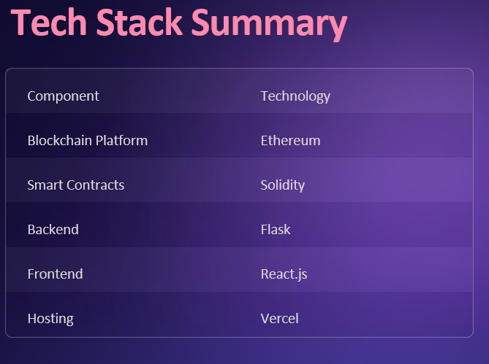

Blockchain Platform
Ethereum
Smart Contracts
Solidity
Backend
Flask
Frontend
React.js
Hosting
Vercel

Slide 6


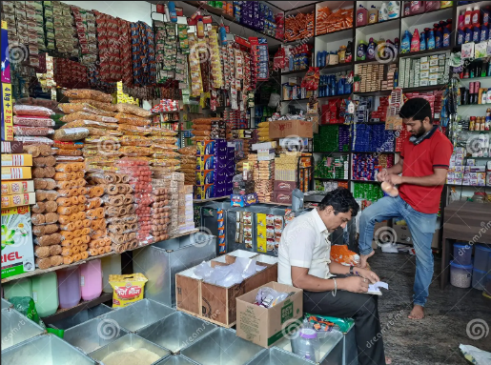


Workflow
User Registration
Users enter personal details and submit their registration. The system verifies eligibility and generates an authorization ID.
Grocery Purchase
Users present their authorization ID at the grocery store. The system verifies the ID and logs the transaction on the blockchain.
Transaction Monitoring
Government officials can access the transaction logs on the blockchain to monitor the distribution process and ensure program integrity.

Slide 7






Conclusion
Enhanced Security
The system significantly reduces the risk of fraudulent claims and misuse, safeguarding the integrity of the program.
Efficient Tracking
Real-time transaction monitoring and immutable records allow program administrators to efficiently track and manage program resources.
Improved Transparency
The transparent and verifiable transaction logs build trust and accountability, empowering beneficiaries and the public to monitor the program.
Effective Program Management
The system streamlines the distribution process, providing insights to optimize program effectiveness and resource allocation.

Slide 8


Thank You

